Slide 1
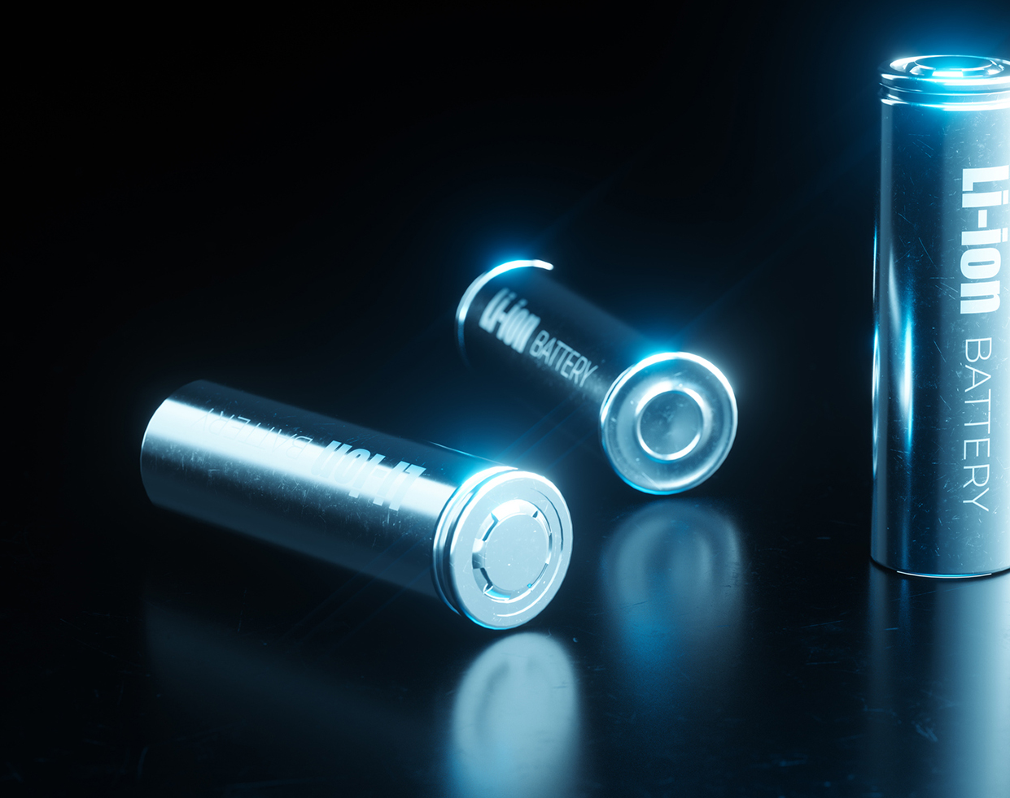
State Estimation & Energy Management Control of Li-Ion BMS using Digital Twin Technology
Problem Statement: Solving the inaccuracy of traditional battery state estimation by merging LSTM models to predict battery state and control/supervise healthy battery operation
Group Members:
Muhammad Farhan Shah (458298)
Kumail Ahmed (459196)
Muhammad Bilal (468188)
Hassan Attique (482073)
BEE15D Group 4

Slide 2

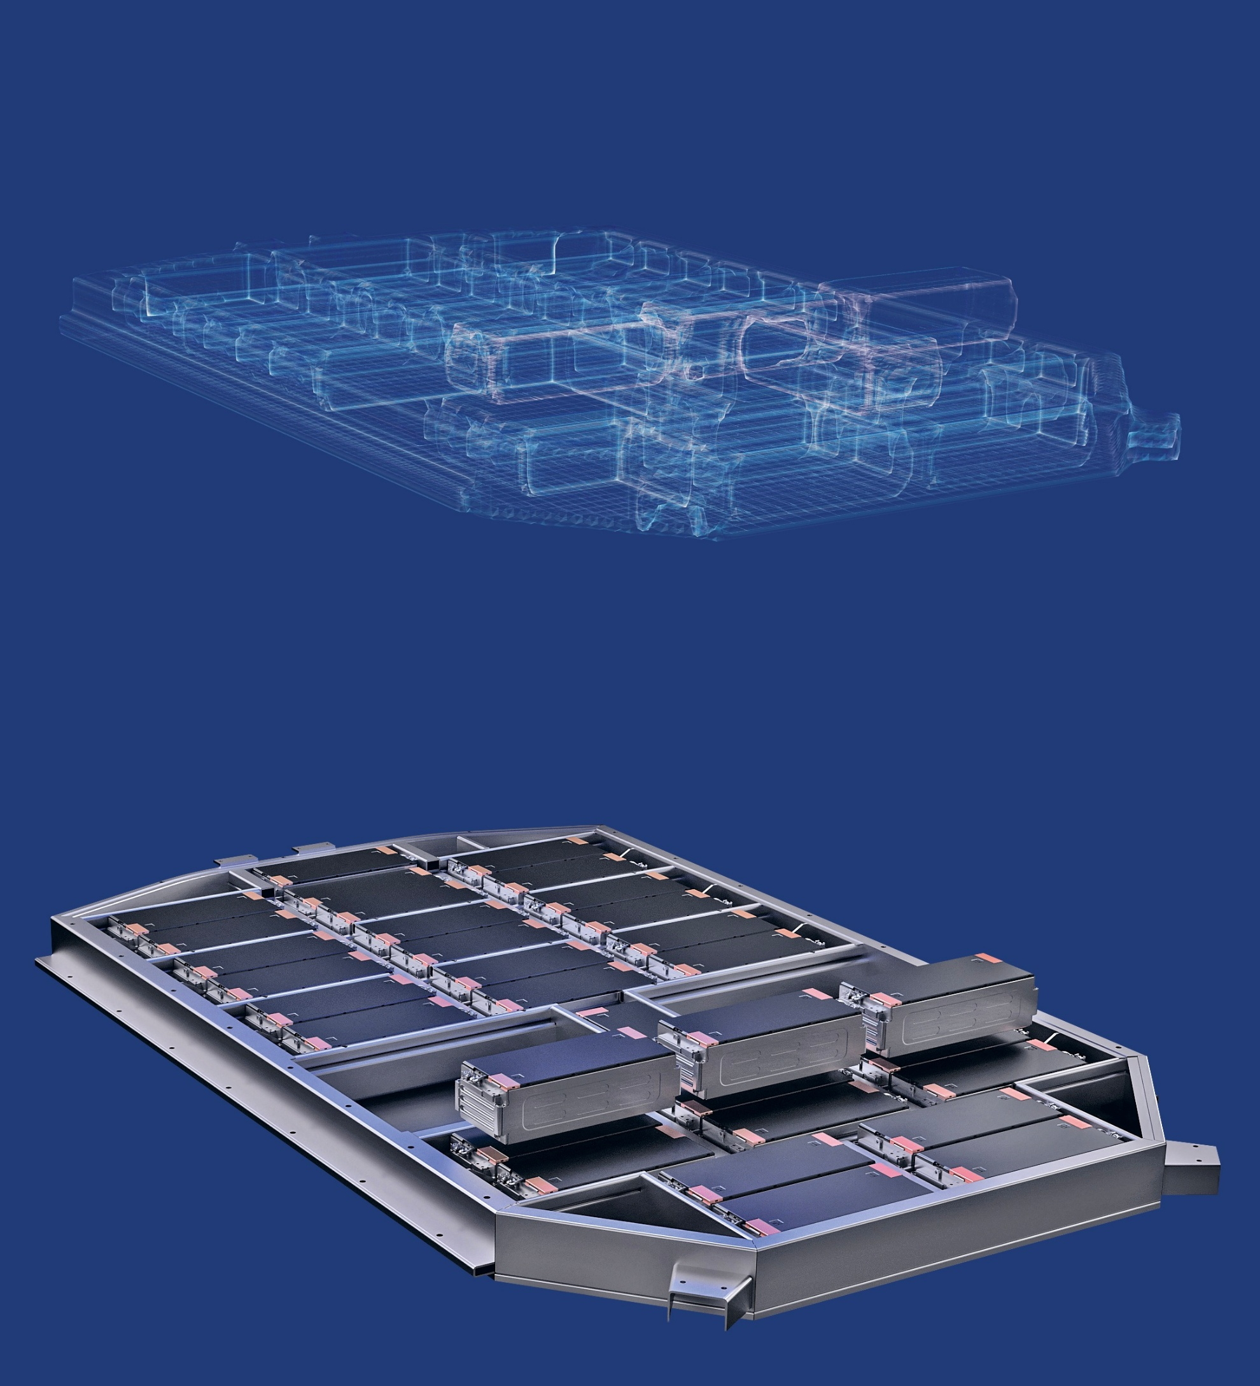
Introduction
Battery Management System
Digital Twin
Functionalities
Protects Against
Overvoltage
Undervoltage
Overcurrent
Thermal Runaway
Short Circuit
Reverse Polarity
Performs
Cell Balancing
Charge Control
Discharge Control
SOC Estimation
Functionalities
Performs
Real Time Monitoring -
Predictive Maintenance -
Data Driven Decision Making -
Performance Optimization -
Lifecycle Management -

Slide 3
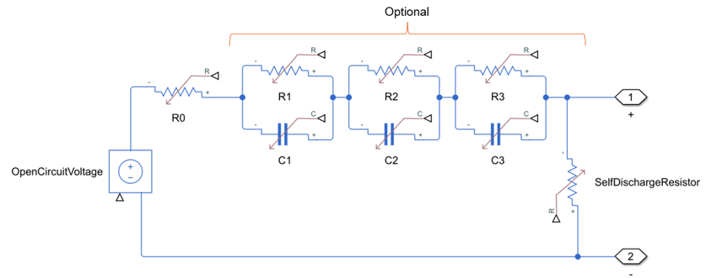
Mathematical Modelling
Battery Management System
Digital Twin
Functionalities
Protects Against
Overvoltage
Undervoltage
Overcurrent
Thermal Runaway
Short Circuit
Reverse Polarity
Performs
Cell Balancing
Charge Control
Discharge Control
SOC Estimation
Functionalities
Performs
Real Time Monitoring -
Predictive Maintenance -
Data Driven Decision Making -
Performance Optimization -
Lifecycle Management -

Slide 4
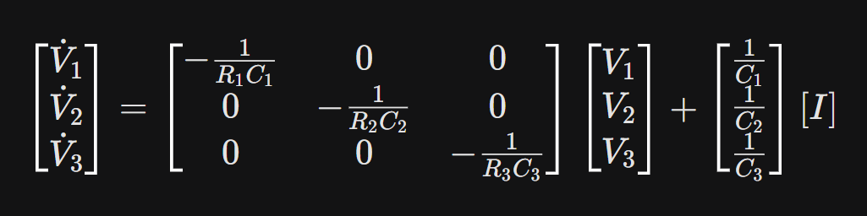
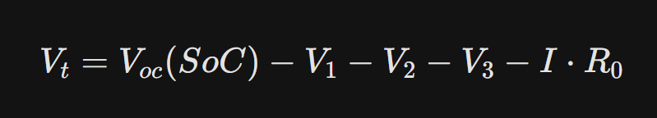

Mathematical Modelling
3rd Order Equivalent Circuit Model of a Lithium Ion Battery
$R_{0}$: Internal Resistance
$R_{1}C_{1}$ (Fast Dynamics) Process: Charge Transfer & Double-Layer Capacitance
$R_{2}C_{2}$ (Medium Dynamics) Process: Ion Diffusion
$R_{3}C_{3} \text{(}\text{Slow} \text{Dynamics}\text{)}$ Process: Electrolyte Diffusion & Concentration Polarization
State Space Representation of the Plant (Li-ion Battery)

Slide 5
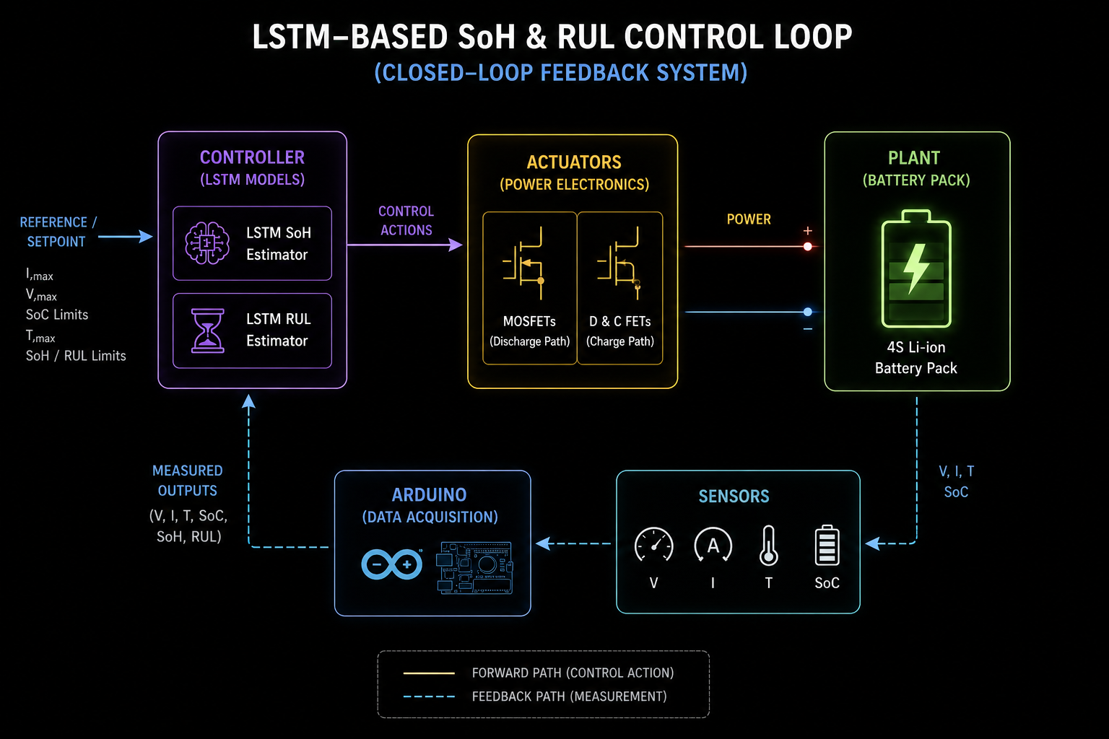

Proposed Controller Design - WorkFlow
A Multiple LSTM Based Supervisory Controller to control C-rate of Li-ion Batteries
BMS Circuit with basic logic to protect against:
- Overvoltage
- Undervoltage
- Overcurrent
- Thermal Runaway
- Short Circuits

Slide 6
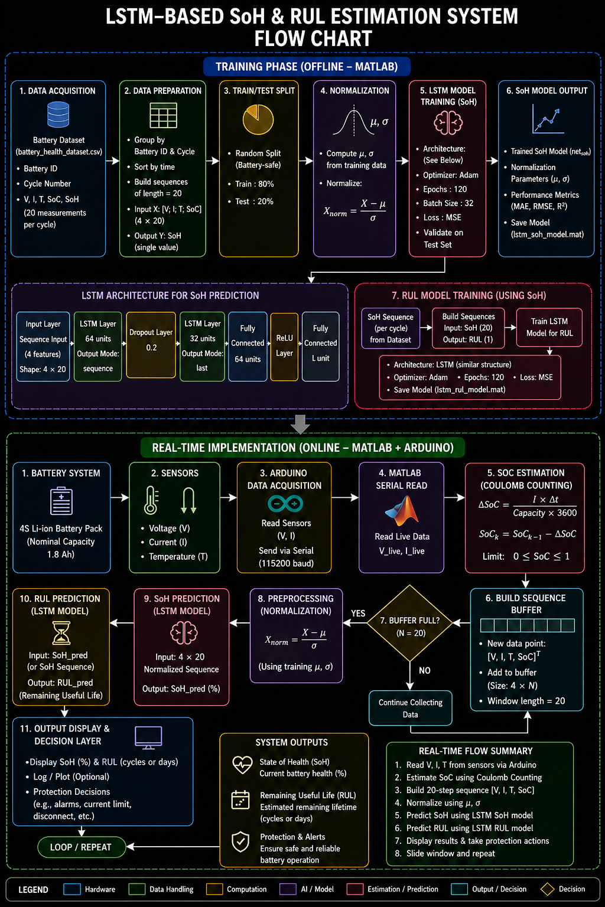
WorkFlow

Slide 7
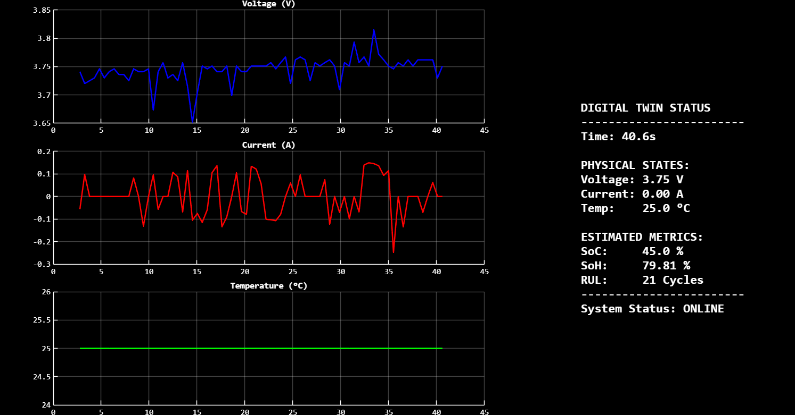
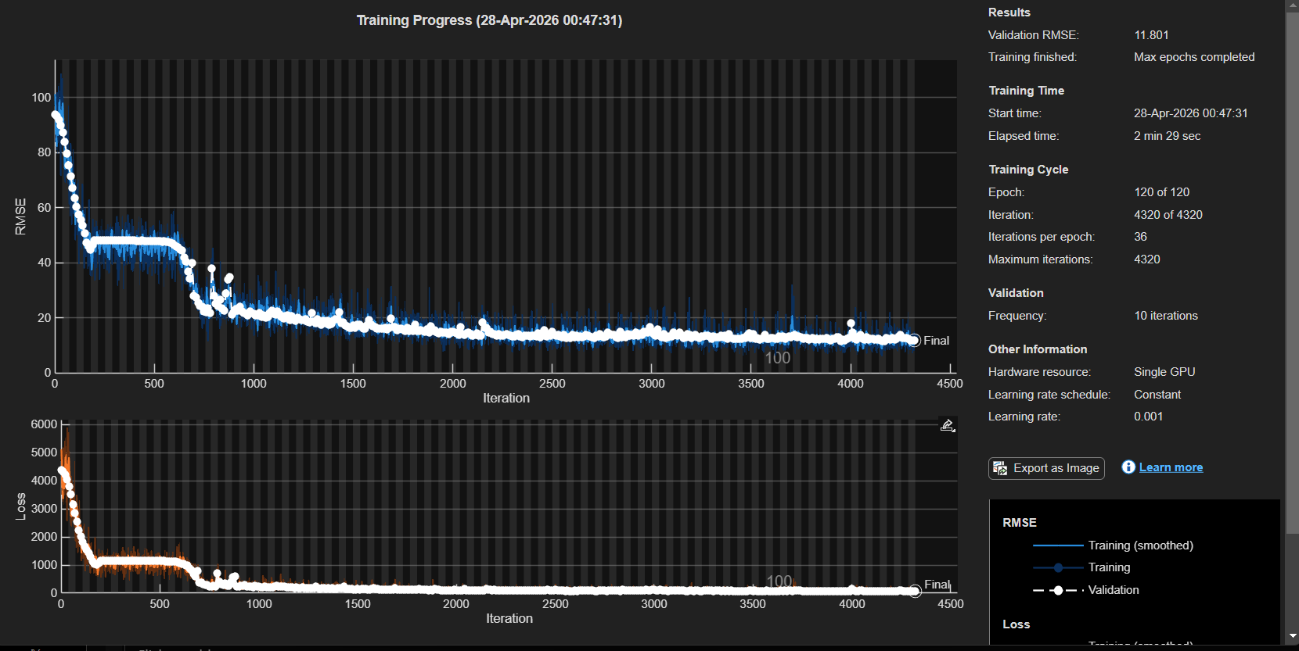
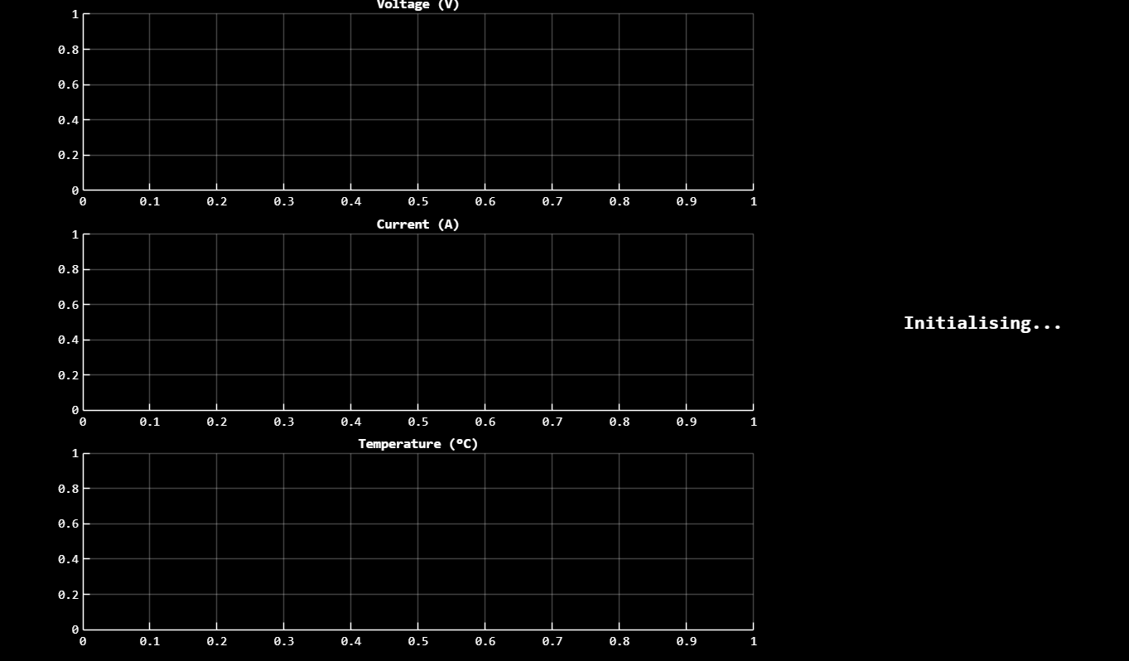
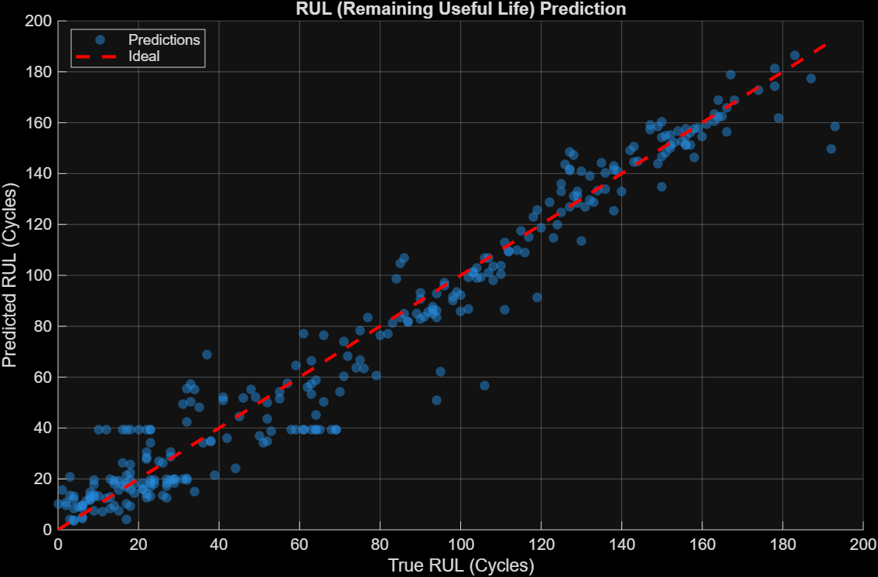
Results

Slide 8

Analysis & Discussion
Control Strategy | Input Parameters | Action taken by System | Physical/Chemical Benefit
Adaptive C-Rate Derating | Predicted SoH | Reduces Max Allowable Current (Throttling) | Minimizes mechanical strain on electrode lattice; prevents lithium plating.
Thermal Power Throttling | Temp (T), SoC | Reduces PWM duty cycle (current load) | Prevents electrolyte decomposition.
End-of-Life (EOL) Prediction | Predicted RUL | Triggers "Service Required" or "Safe Mode" | Prevents catastrophic failure or sudden power loss in critical applications.
Internal Resistance Compensation | V, I (Ohm's Law) | Adjusts voltage cut-off limits | Accounts for increased R0 as battery ages to prevent premature shutdown.
Dynamic Energy Reserve | SoC, SoH | Dynamically adjusts the "0% SoC" floor | Protects the battery from deep discharge, which causes irreversible capacity loss.
Stress Factor Mitigation | V, I, T | Limits high-power bursts during low SoC | Reduces the risk of internal short-circuits caused by dendrite growth.

Slide 9
Conclusions
Predictive Control: Replaced reactive monitoring with LSTM forecasting to manage degradation before reaching critical thresholds.
Digital Twin: Integrated Arduino telemetry with cascaded neural networks to precisely estimate hidden SoH and RUL states.
Closed-Loop Optimization: Autonomous hardware control, like C-rate throttling, extends battery life and improves operational safety.

Slide 10
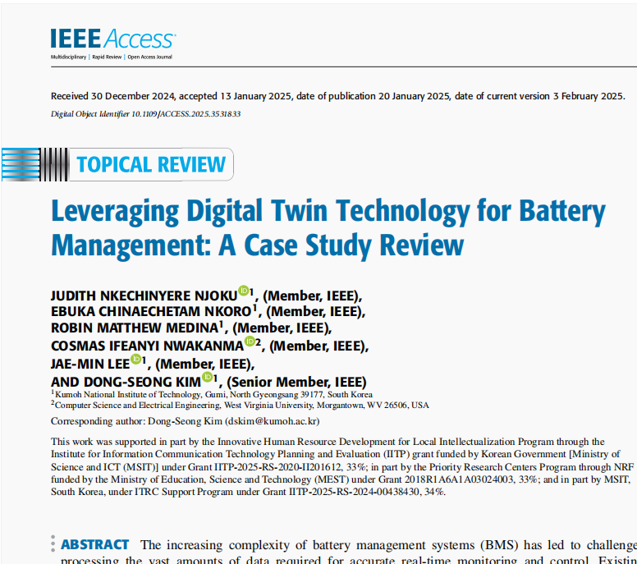
Current Research Areas
References
Electric Vehicles (EVs)
Grid Energy Storage Systems (BESS)
Consumer Electronics
Electric Aviation (eVTOL)
Second-Life Battery Grading
Marine Electrification
Heavy Industrial Equipment
Space Exploration Systems
Unmanned Aerial Vehicles (Drones)
Medical Device Power Management
IEEE Research Paper –
Leveraging Digital Twin Technology for Battery
Management: A Case Study Review

